Slide 1


Course
Introduction

Slide 2

Course Overview

Slide 3



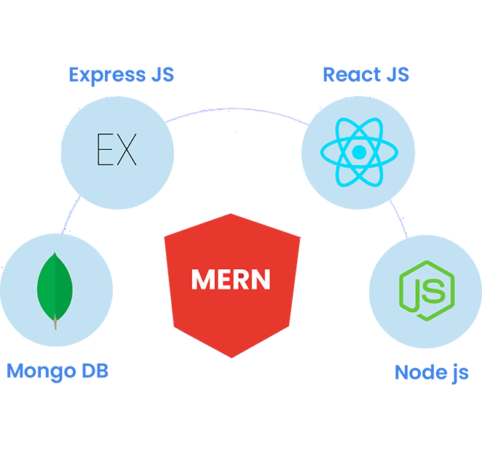
Technologies Covered

Slide 4

Learning Objectives

Slide 5

Prerequisites

Slide 6

Course Material

Slide 7

Projects

Slide 8
Let The Journey Begin

Slide 9

THANK YOU

